Slide 1
Social Engineering
Dr. Abdelrahman H. Hussein

Slide 2
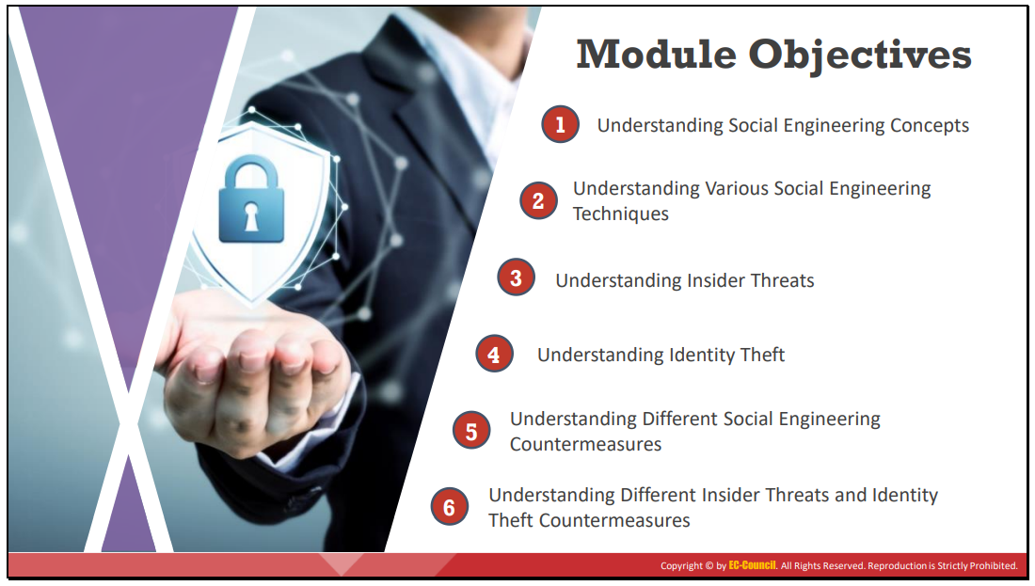

Slide 3
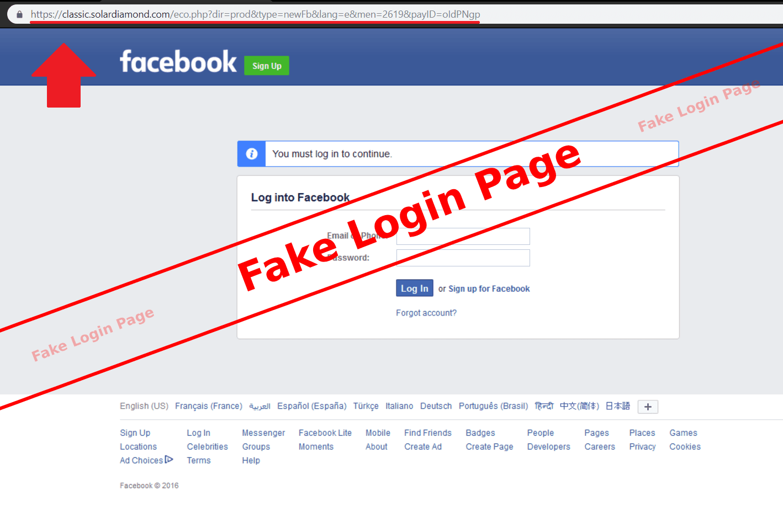
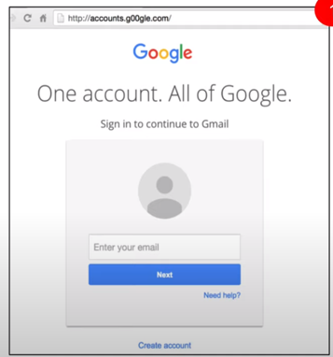
الاخطاء الموجودة في الصفحتين

Slide 4
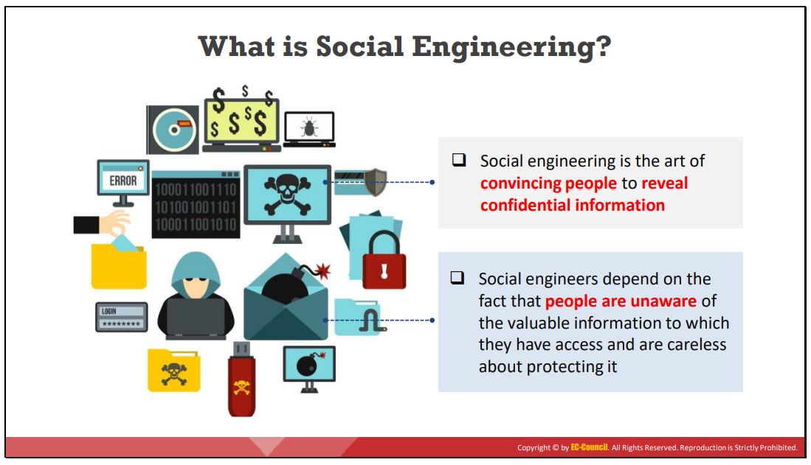
Notes:
Convincing : اقناع
What is Social Engineering? Before performing a social engineering attack, the attacker gathers information about the target organization from various sources such as:
The organization’s official websites, where employees’ IDs, names, and email addresses are shared
Advertisements of the target organization cast through media reveal information such as products and offers.
Blogs, forums, and other online spaces where employees share basic personal and organizational information.
After gathering information, an attacker executes social engineering attacks using various approaches such as impersonation, piggybacking, tailgating, reverse social engineering, and other methods

Slide 5
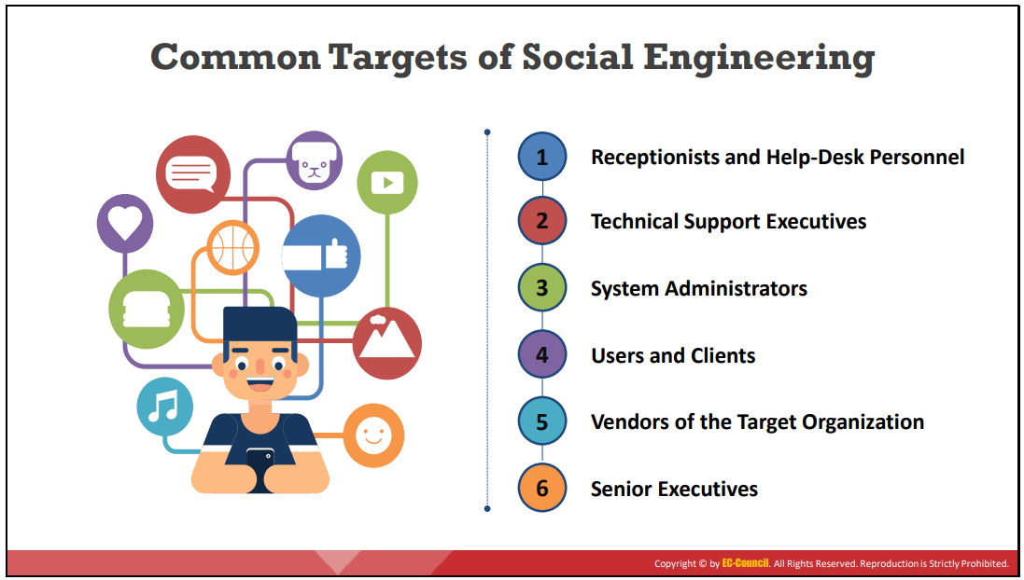

Slide 6
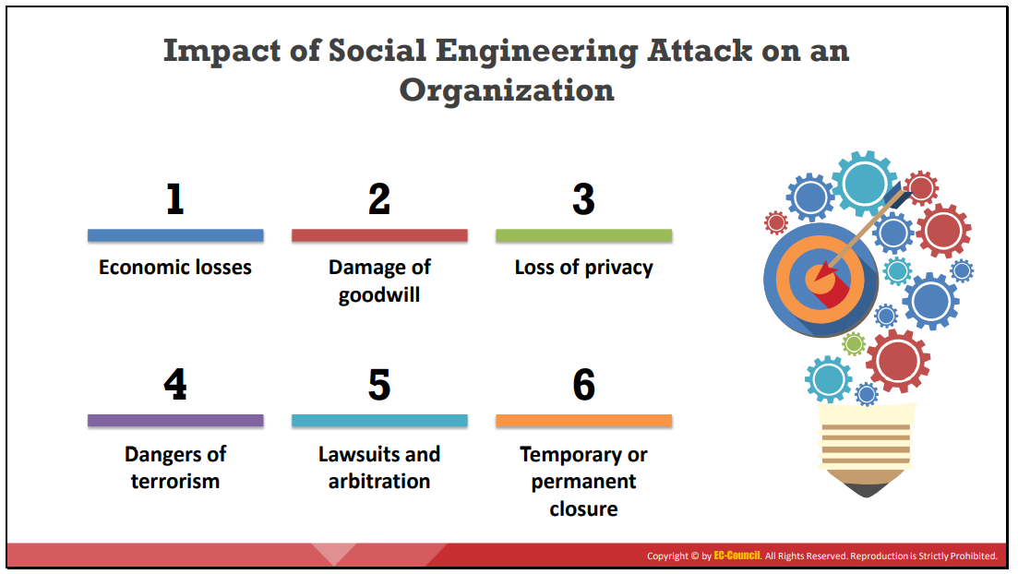
Notes:
LAWSUITS AND ARBITRATION : الدعاوى القضائية والتحكيم
TEMPORARY OR PERMANENT CLOSURE إغلاق مؤقت أو دائم
DAMAGE OF GOODWILL ضرر حسن النية

Slide 7
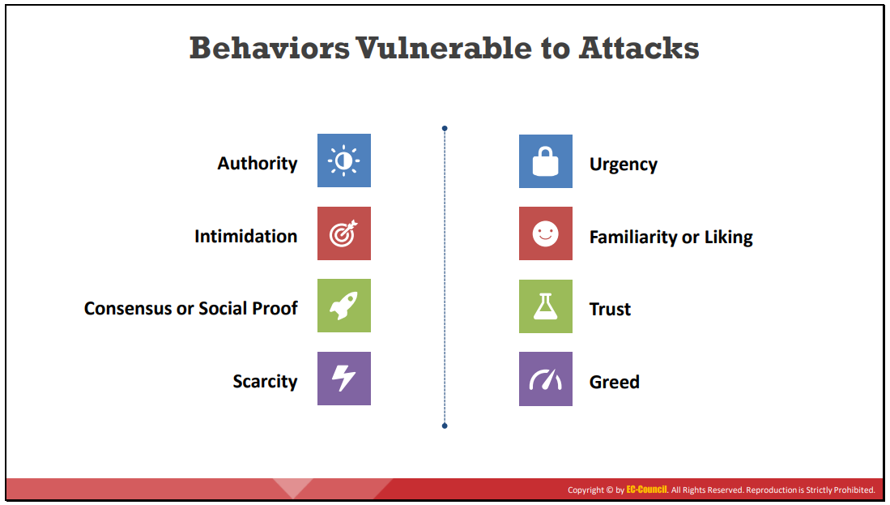

Slide 8
Social Engineering Tactics
Social engineering tactics, to influence people, include:
Authorityالسلطة: people are more likely to complyاستجاب when instructed by “an authority”
Intimidationتخويف: criminals bully a victim into taking action.
An executive's secretary receives a call stating that her boss is about to give an important presentation, but his files are corrupt. The cybercriminal asks for the files to be sent immediately to him.
Consensus/Social Proof(اجماع): people will take action if they think that other people like it too.
Consensus Criminals create websites with fake testimonials(توصية that promote a product indicating that it is safe.
Scarcityنقص: people will take action when they think there is a limited quantity.
Criminals offer a limited opportunity that will not last hoping to spur the victim into taking action quickly
Notes:
Intimidation تخويف Consensus إجماع Scarcity نقص bully بلطجي subpoena استدعاء spur حافز

Slide 9
Cont.
Urgency: people will take action when they think there is a limited time.
Criminals establish a deadline for taking action based on a certain price.
Familiarity/Liking: Criminals build a rapport with the victim to establish a relationship.
People are more likely to do what another person asks if they like that person.
Trust: Criminals build a trusting relationship with a victim which may require more time to establish.
A "security expert" calls the victim offering advice and having the credentials to back it up. While helping the victim, the criminal discovers a "serious error' that needs immediate attention. The solution provides the criminal with the opportunity.
Notes:
Rapport علاقة

Slide 10
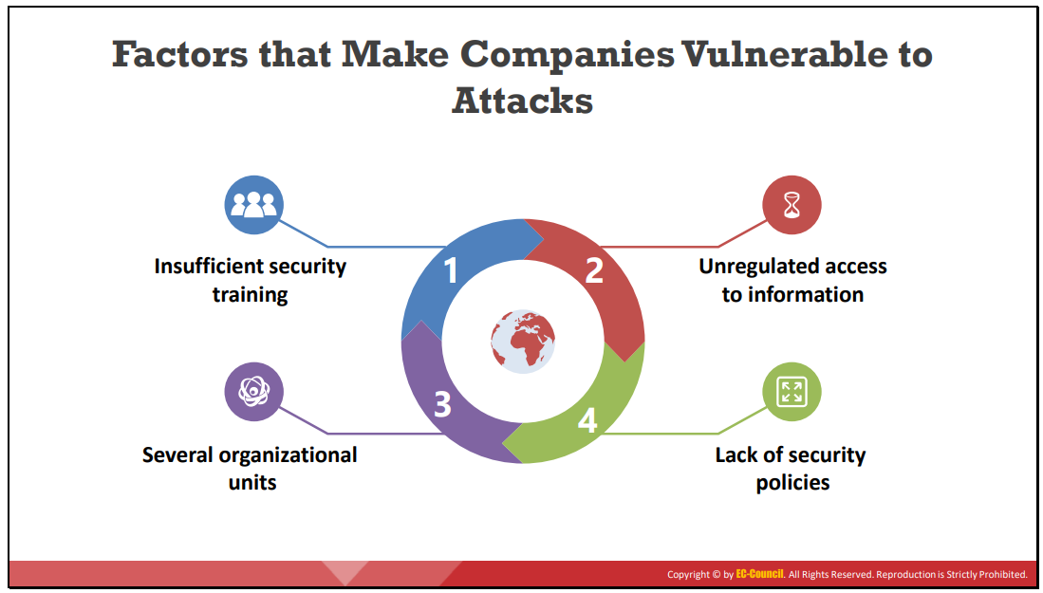
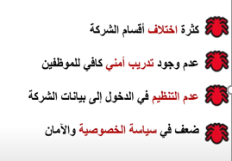
Notes:
Many factors make companies vulnerable to social engineering attacks; some of them are as follows:
▪ Insufficient Security Training: Employees can be ignorant about the social engineering tricks used by attackers to lure them into divulging sensitive data about the organization. Therefore, the minimum responsibility of any organization is to educate their employees about social engineering techniques and the threats associated with them to prevent social engineering attacks.
▪ Unregulated Access to Information: For any company, one of its main assets is its database. Providing unlimited access or allowing everyone access to such sensitive data might cause trouble. Therefore, companies must ensure proper training for and surveillance of key personnel accessing sensitive data.
▪ Several Organizational Units: Some organizations have their units at different geographic locations, making it difficult to manage the system. Further, this sort of setup makes it easier for an attacker to access the organization’s sensitive information.
▪ Lack of Security Policies: Security policy is the foundation of security infrastructure. It is a high-level document describing the security controls implemented in a company. An organization should take extreme measures related to every possible security threat or vulnerability. Implementation of certain security measures such as password change policy, information sharing policy, access privileges, unique user identification, and centralized security, prove to be beneficial. All Rights Reserved. Reproduction is Strictly Prohibited.

Slide 11
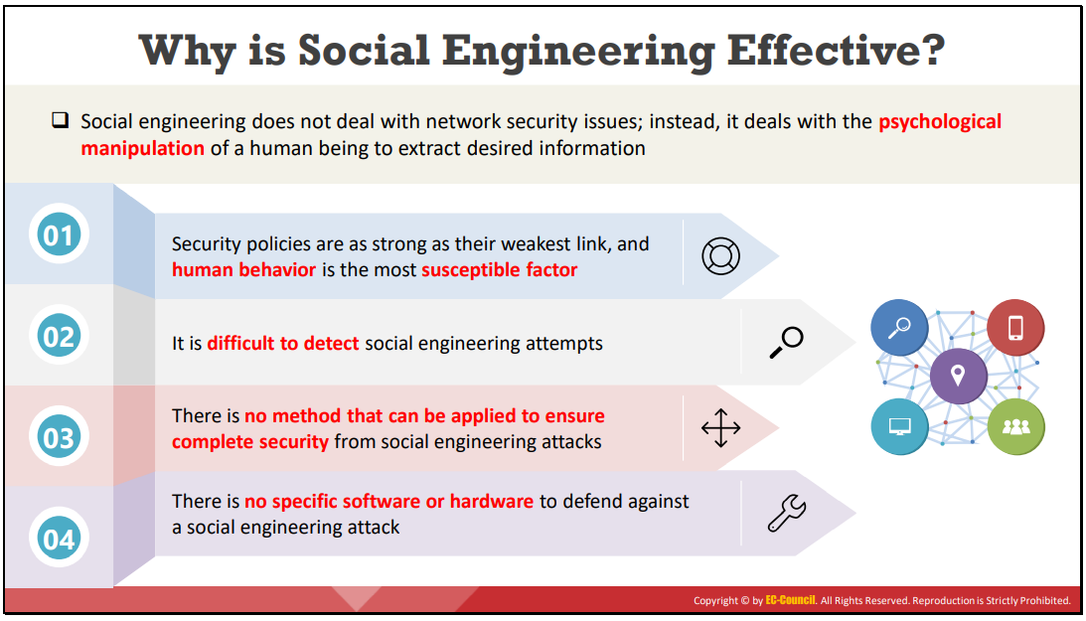
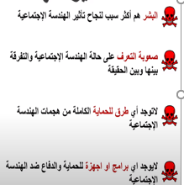
Notes:
The following are reasons why social engineering continues to be effective:
Despite various security policies, preventing social engineering is a challenge because human beings are most susceptible to variation.
It is challenging to detect social engineering attempts. Social engineering is the art and science of manipulating people into divulging information.
No method guarantees complete security from social engineering attacks.
No specific hardware or software is available to safeguard against social engineering attacks.
This approach is relatively cheap (or free) and easy to implement.
People have faith in technology used to secure IT assets.
Publicly available information on the Internet or information collected through opensource intelligence allows in planning successful social engineering attacks.

Slide 12
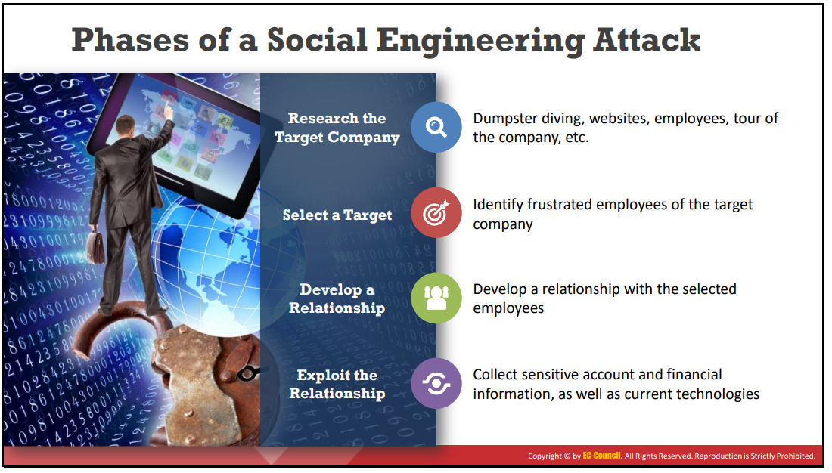

Slide 13
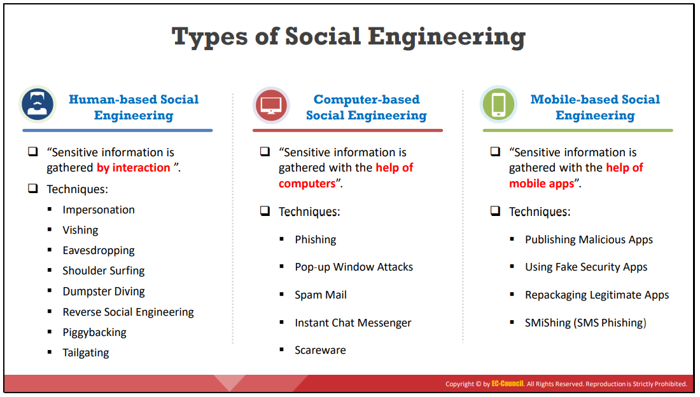

Slide 14
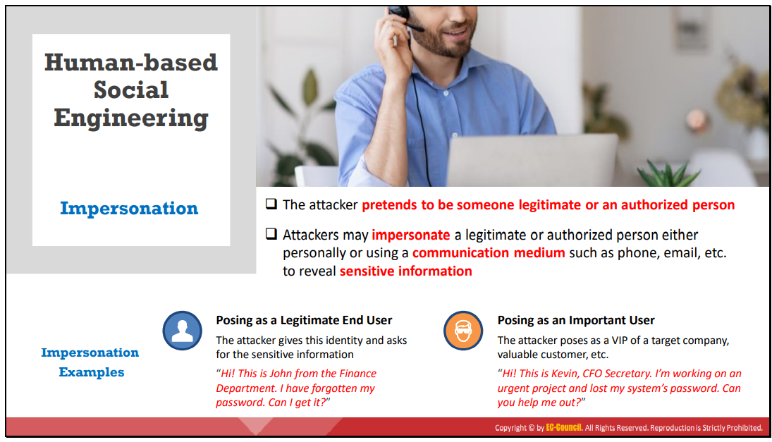
Notes:
تظاهرPRETEND

Slide 15
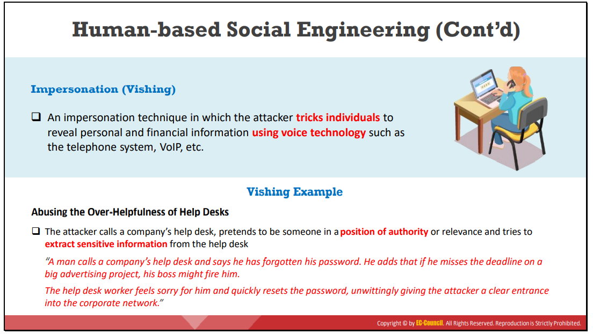

Slide 16
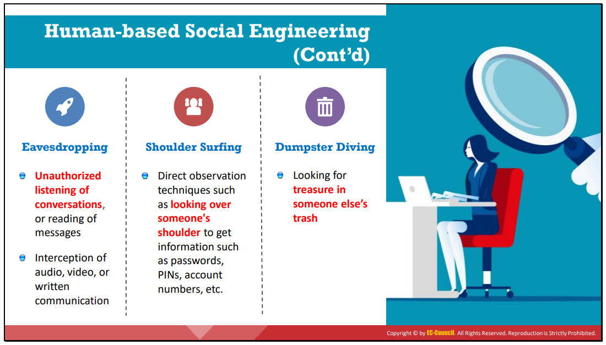

Slide 17
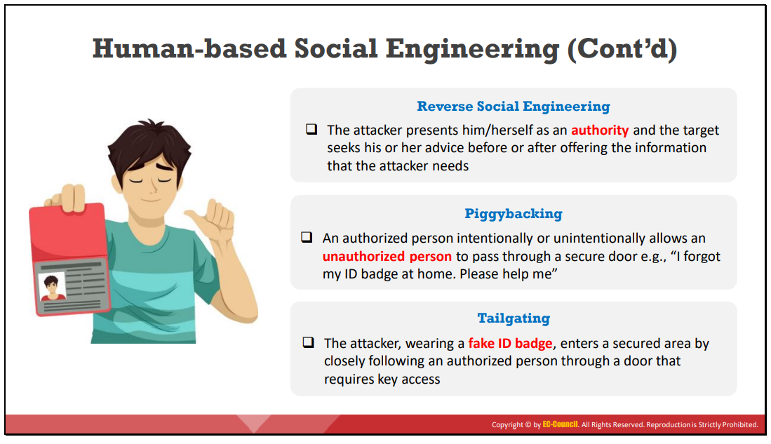

Slide 18
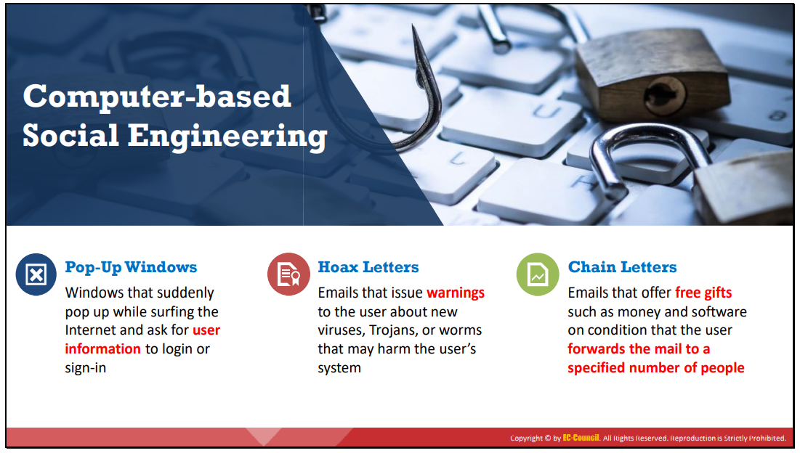

Slide 19
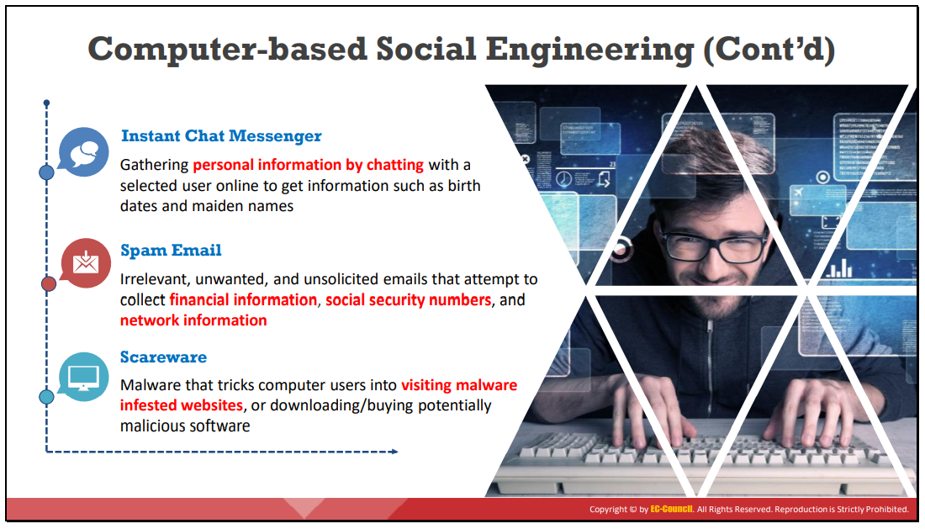

Slide 20
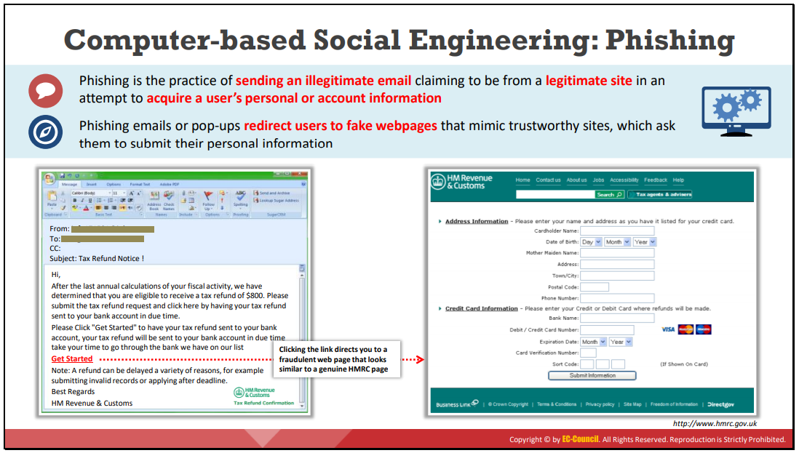

Slide 21
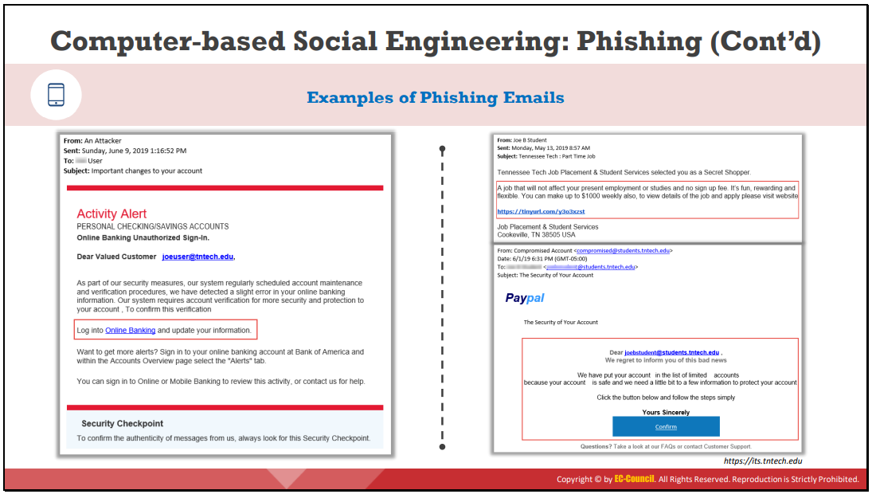

Slide 22
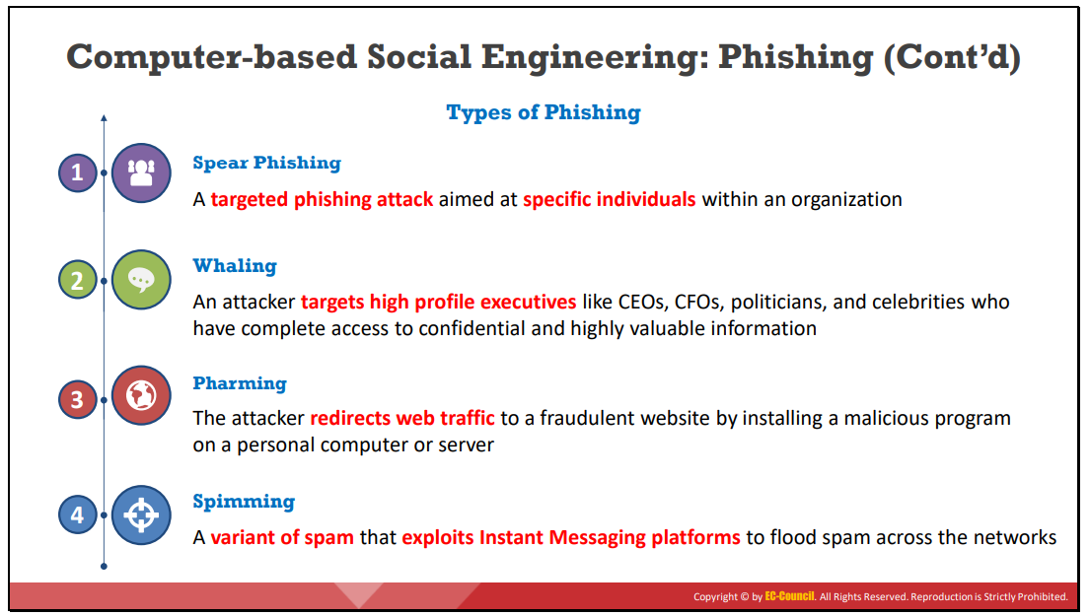

Slide 23
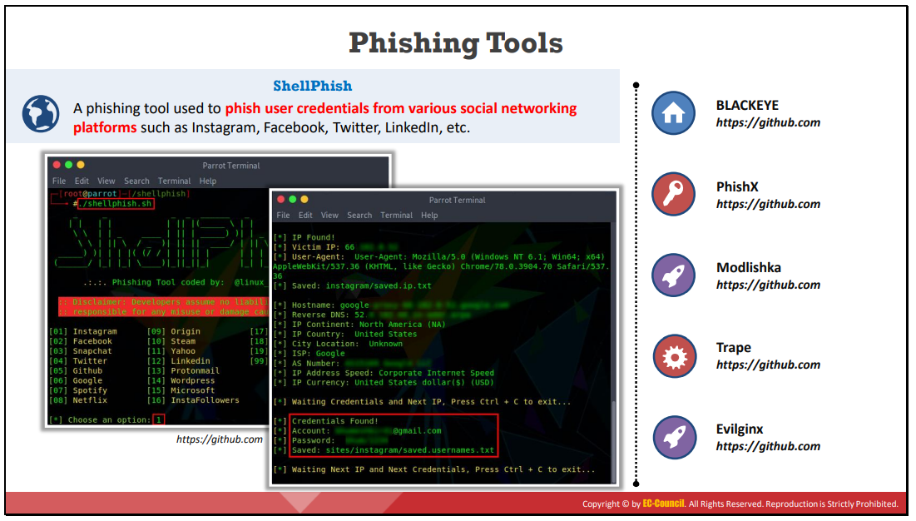

Slide 24
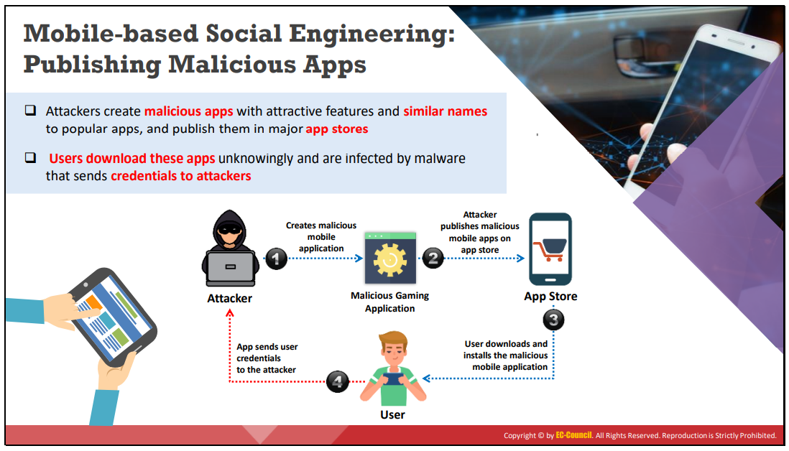

Slide 25
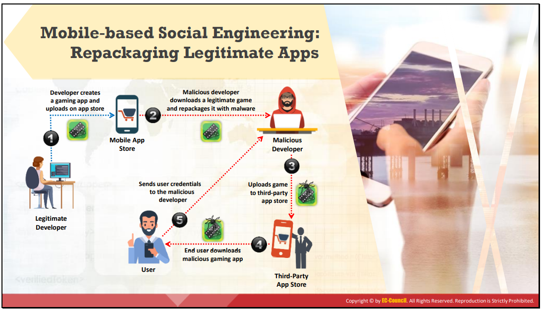

Slide 26
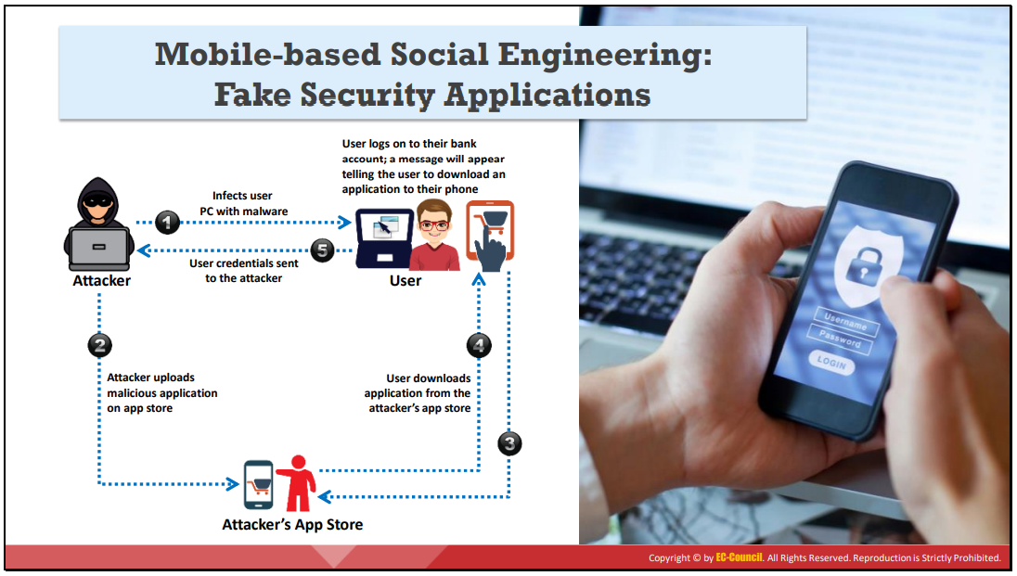

Slide 27
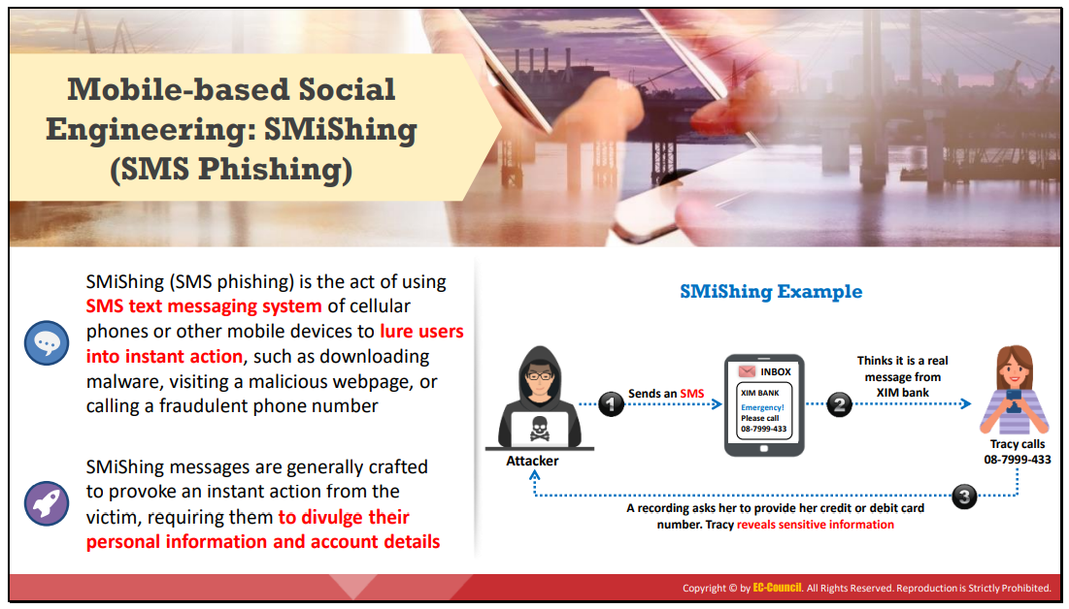

Slide 28
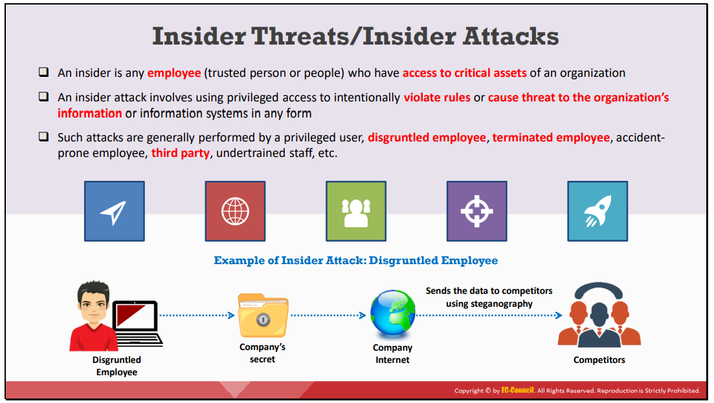

Slide 29
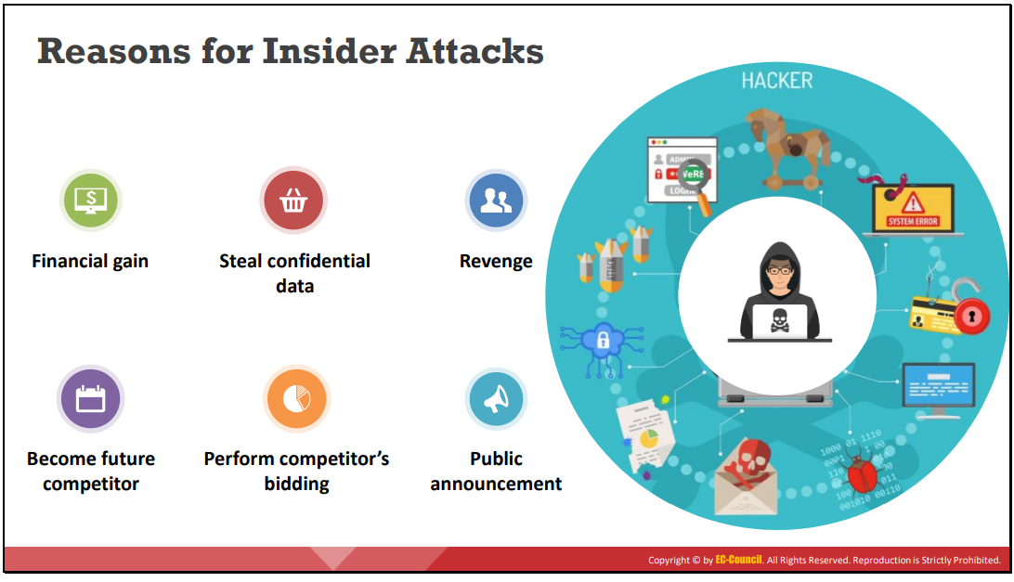

Slide 30
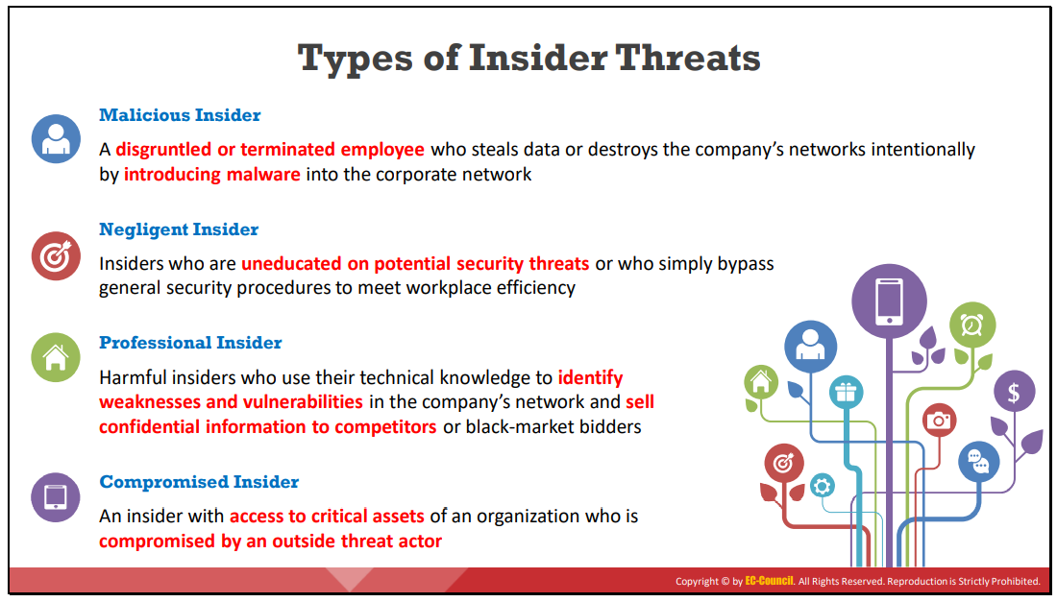

Slide 31
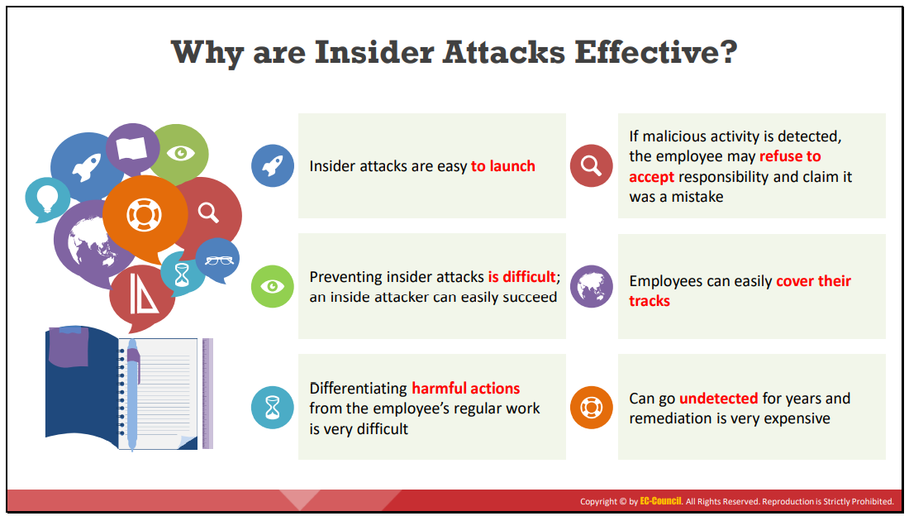

Slide 32
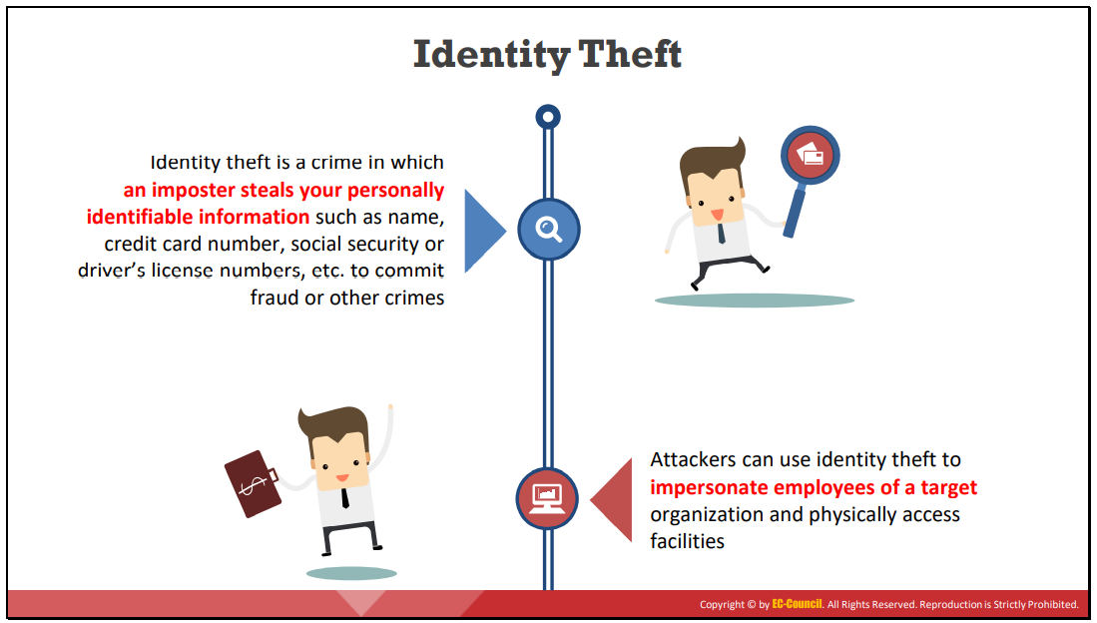

Slide 33
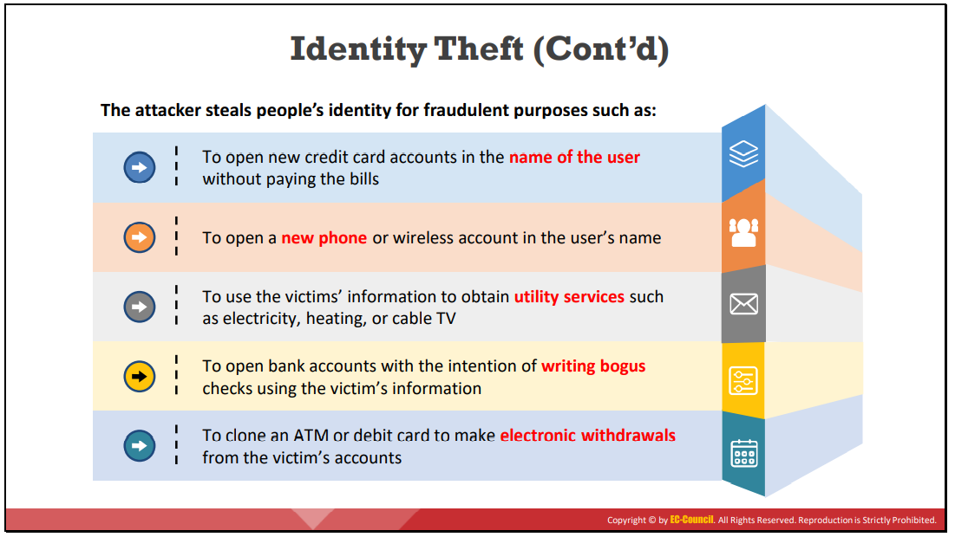

Slide 34
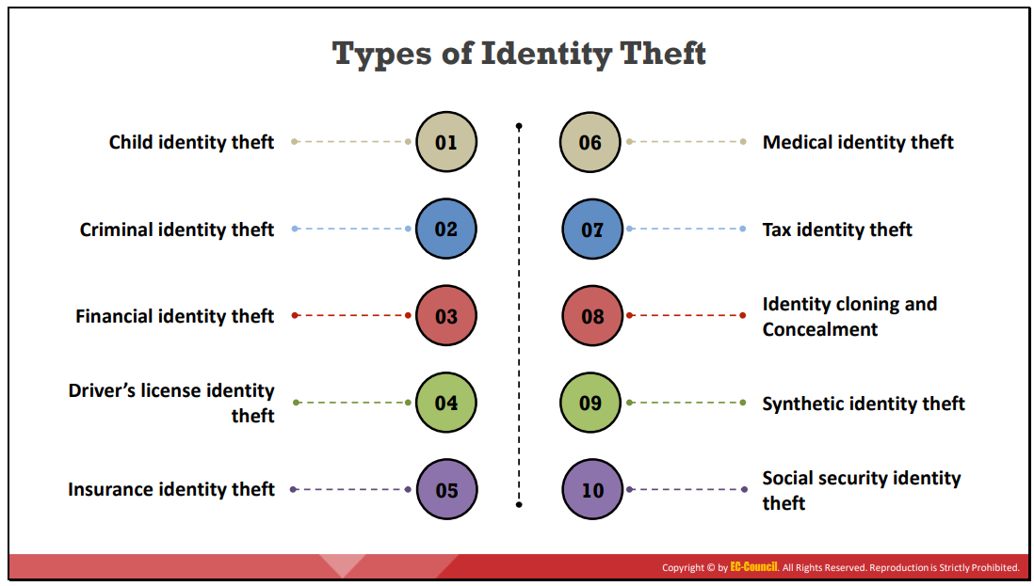

Slide 35
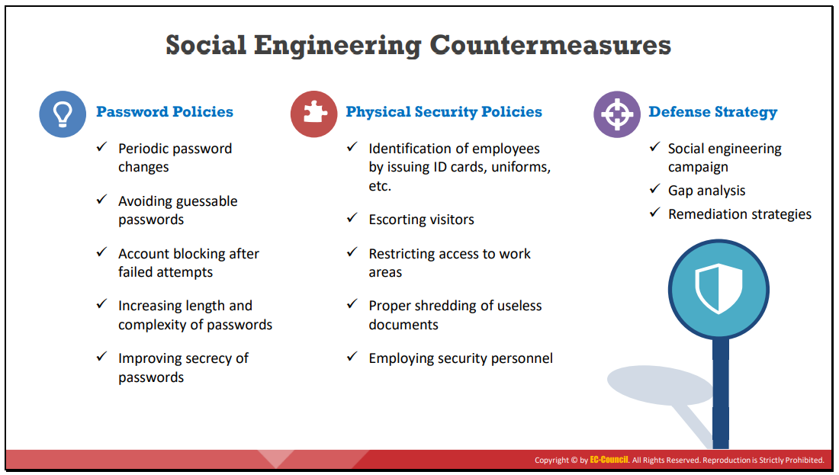

Slide 36
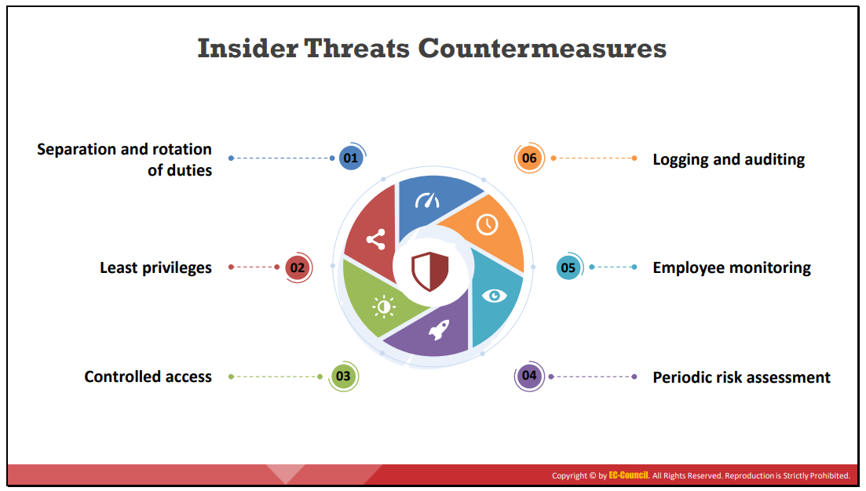

Slide 37
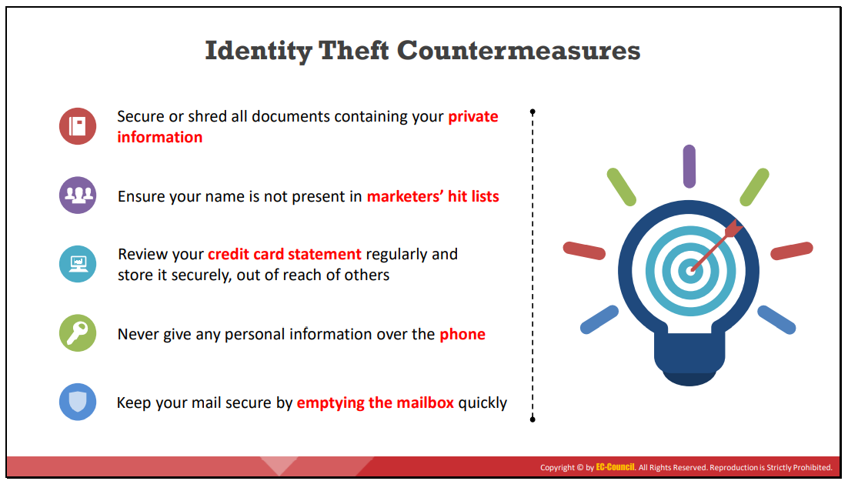

Slide 38
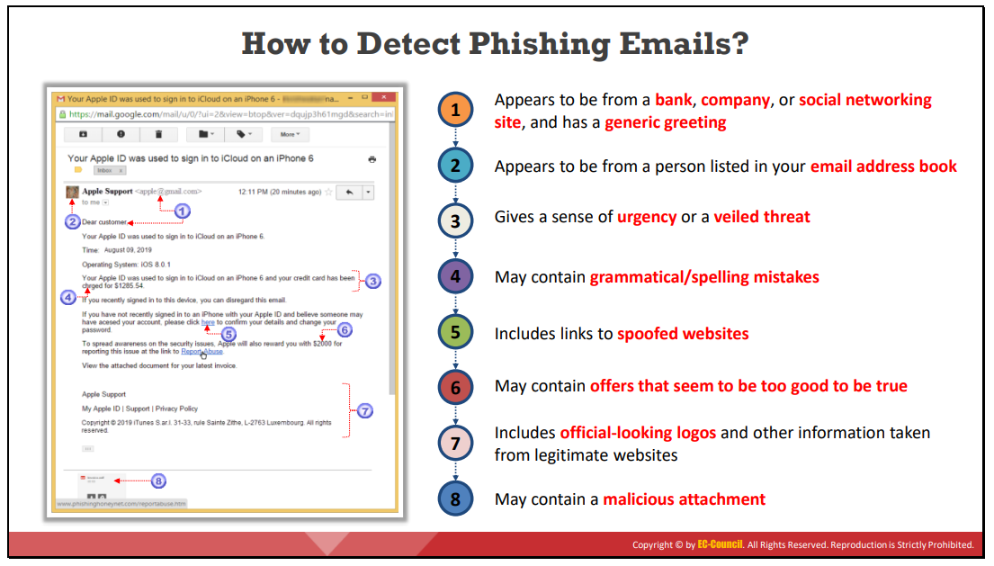

Slide 39
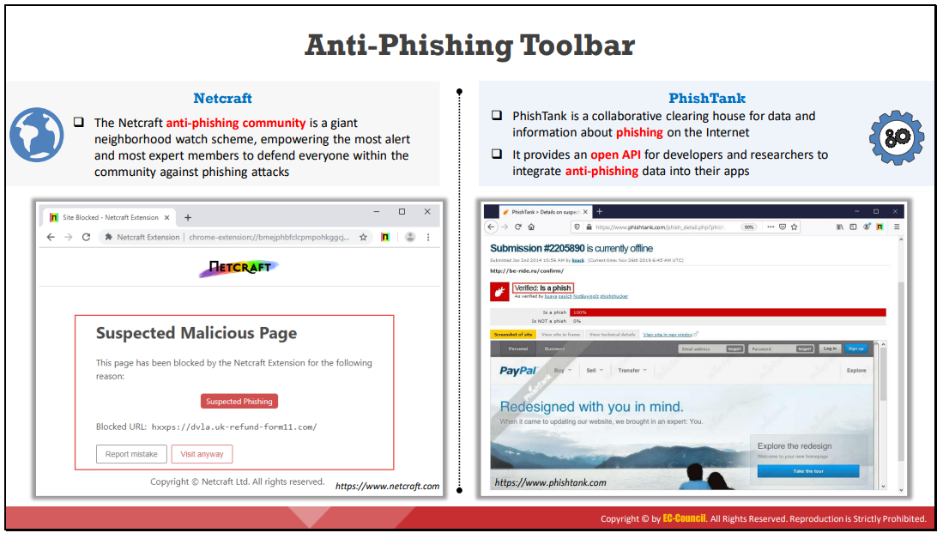

Slide 40
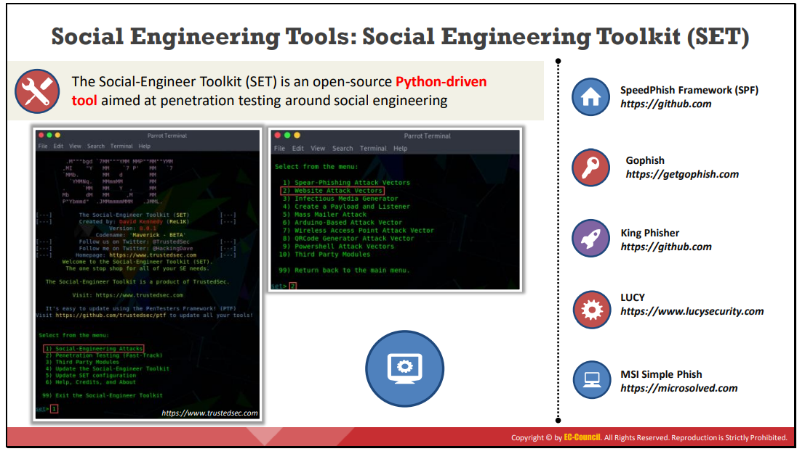

Slide 41
